Slide 1
The definition of my landform :
Ocean are just few of many natural features that make up our earth.

Slide 2
How my landform is formed:
These under water landscapes are in a endless cycle of construction and destruction the new crust is born along mid-ocean.

Slide 3
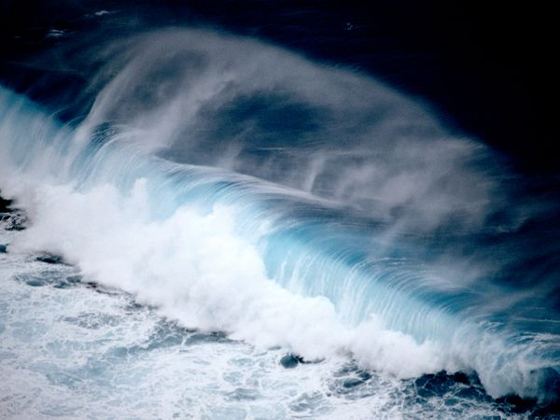
Where can my landform:
The pacific ocean is found all over the world.

