Slide 1
Coast Lines
All About coast lines.

Slide 2
The definition of my landform:
A narrow strip of land that borders the sea along a continent,or an island.

Slide 3
How my landform is formed:
A beach forms when waves deposit sand and gravel along the shoreline.

Slide 4
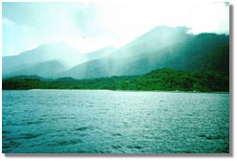
Where can my landform be found and a picture of it:
It can be found in Florida which has 770 coast lines . But Alabama has only 53 coast lines.

